Slide 1




NEXT GEN EMPLOYABILITY PROGRAM
Creating a future-ready workforce
Team Members
College Name
Student Name : Jaya Suriya S
Student ID : au814721104025
SRMTRPEC

Slide 2

CAPSTONE PROJECT SHOWCASE
Project Title
Notes Sharing Web Application using Django Framework
Abstract | Problem Statement | Project Overview | Proposed Solution | Technology Used | Modelling & Results | Conclusion

Slide 3
Abstract
The proposed web application aims to facilitate file sharing between students and teachers in an educational setting. Built using the Django framework, the application will provide a user-friendly interface for uploading, downloading, and managing files. Users will be able to create accounts, join specific groups (e.g., classes or departments), and share files within these groups. The application will prioritize security and privacy, ensuring that files are accessible only to authorized users. Overall, the goal is to streamline the file-sharing process and enhance collaboration within educational communities.

Slide 4
Problem Statement
In traditional educational environments, sharing files between students and teachers can be inefficient and cumbersome. Students often need to submit assignments or access resources, while teachers need to distribute materials and provide feedback. However, existing methods, such as email or physical submissions, lack organization and can lead to confusion or lost files.To address these challenges, this project aims to develop a web application that enables seamless file sharing between students and teachers. The application will provide a centralized platform for uploading, downloading, and managing files, enhancing collaboration and efficiency within educational communities.

Slide 5
Project Overview
The project involves developing a web application using Django to facilitate file sharing between students and teachers. The application will provide a user-friendly interface for uploading, downloading, and managing files, with features tailored to the needs of educational environments.Key Features:User Authentication: Students and teachers can create accounts and log in to the system.File Upload and Download: Users can upload files to share with others and download files shared by others.Group Creation and Management: Users can create groups (e.g., classes or departments) and share files within these groups.Access Control: Files are accessible only to authorized users, ensuring security and privacy

Slide 6
Proposed Solution
.
The proposed solution is to develop a web application using Django that provides a centralized platform for students and teachers to share files. The application will have the following key components:User Management: Users (students and teachers) will be able to create accounts, log in, and manage their profiles. User authentication will ensure that only authorized users can access the system.File Management: Users will be able to upload files to the system, organize them into folders, and download files shared by others.

Slide 7


Technology Used
Front-end
Back-end

Slide 8
Modelling & Results
For the students and teacher there is an login and sign up page this will be the landing page of
this webapp and there are some validation process such as user name , password and after
the login there comes home page where students loged in can see and download
the files shared bythe teachers and when the teacher logs in he/she will have options to upload
a file when the user name and password does not matches web page shows no access

Slide 9
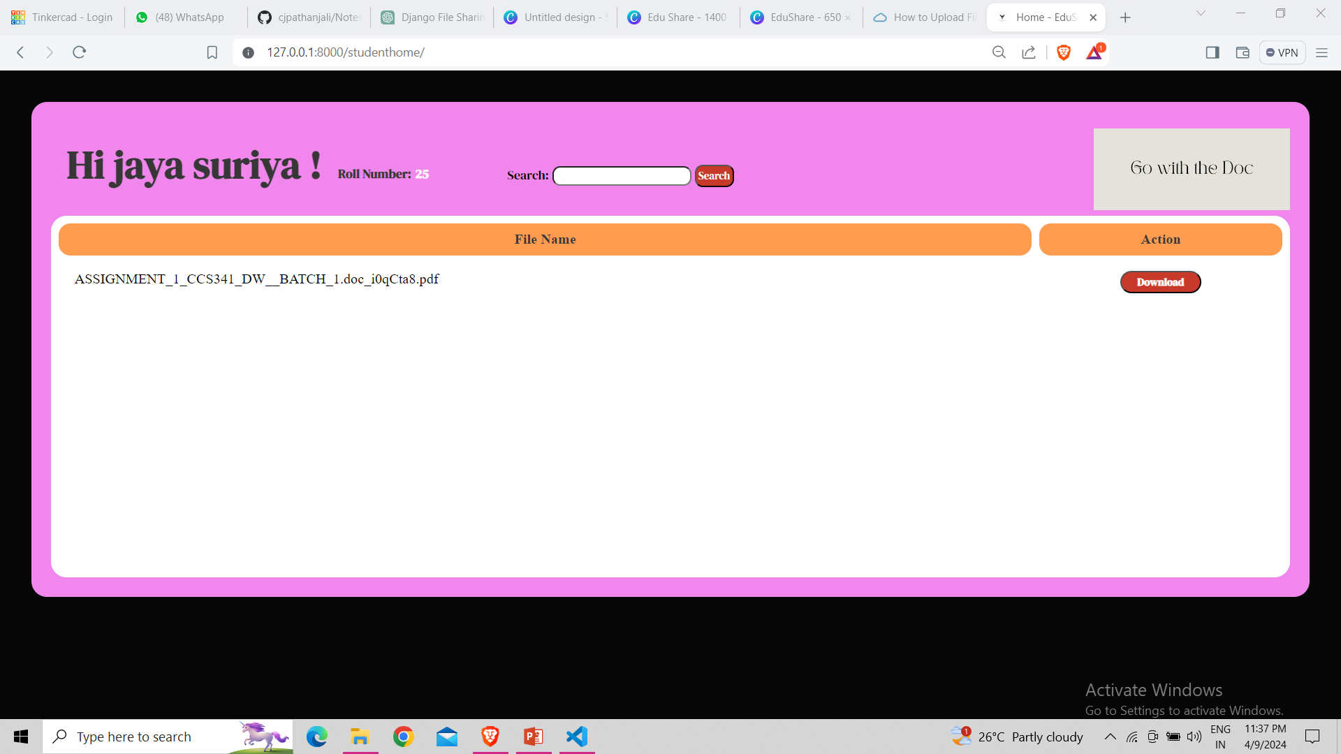
Homepage

Slide 10
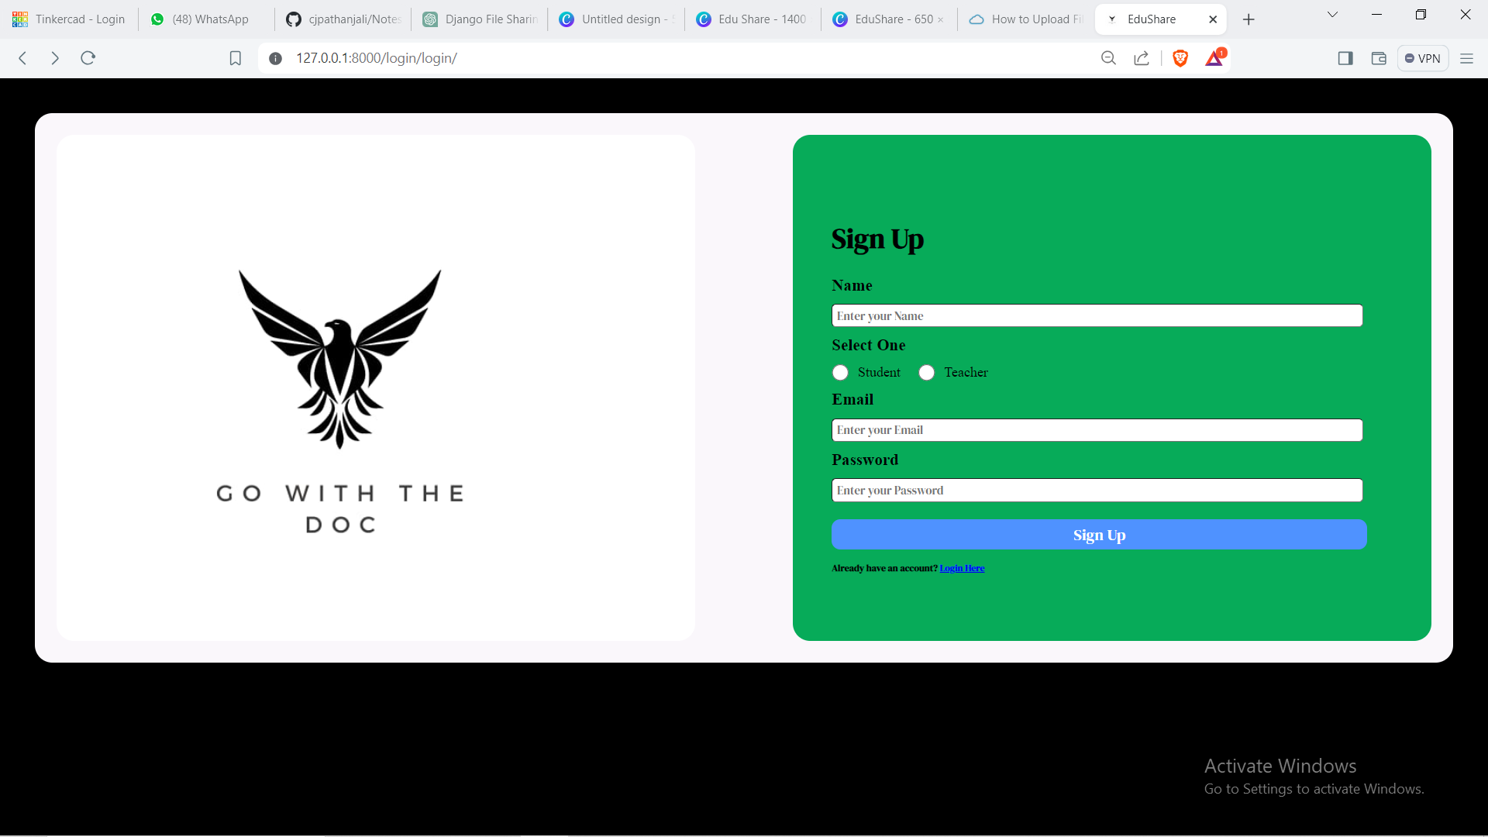
Sign up page

Slide 11
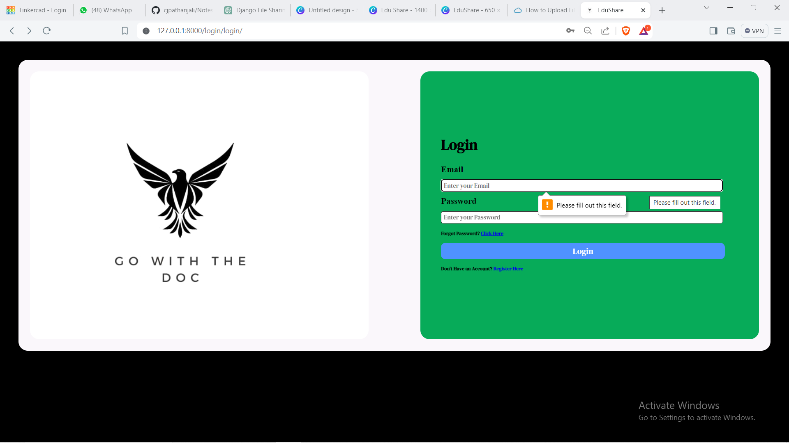
Login page

Slide 12
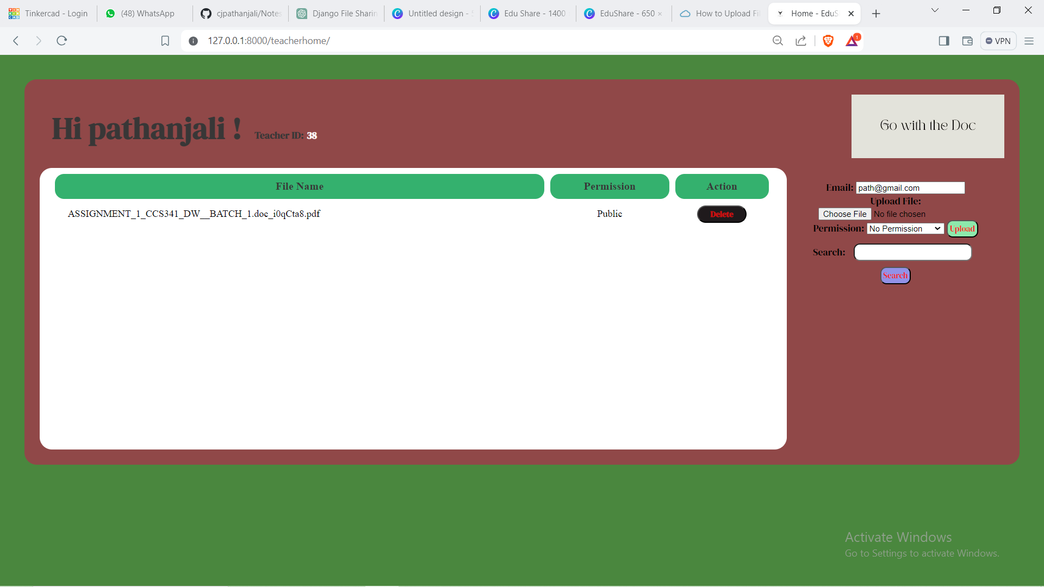
Teachers Home Page

Slide 13
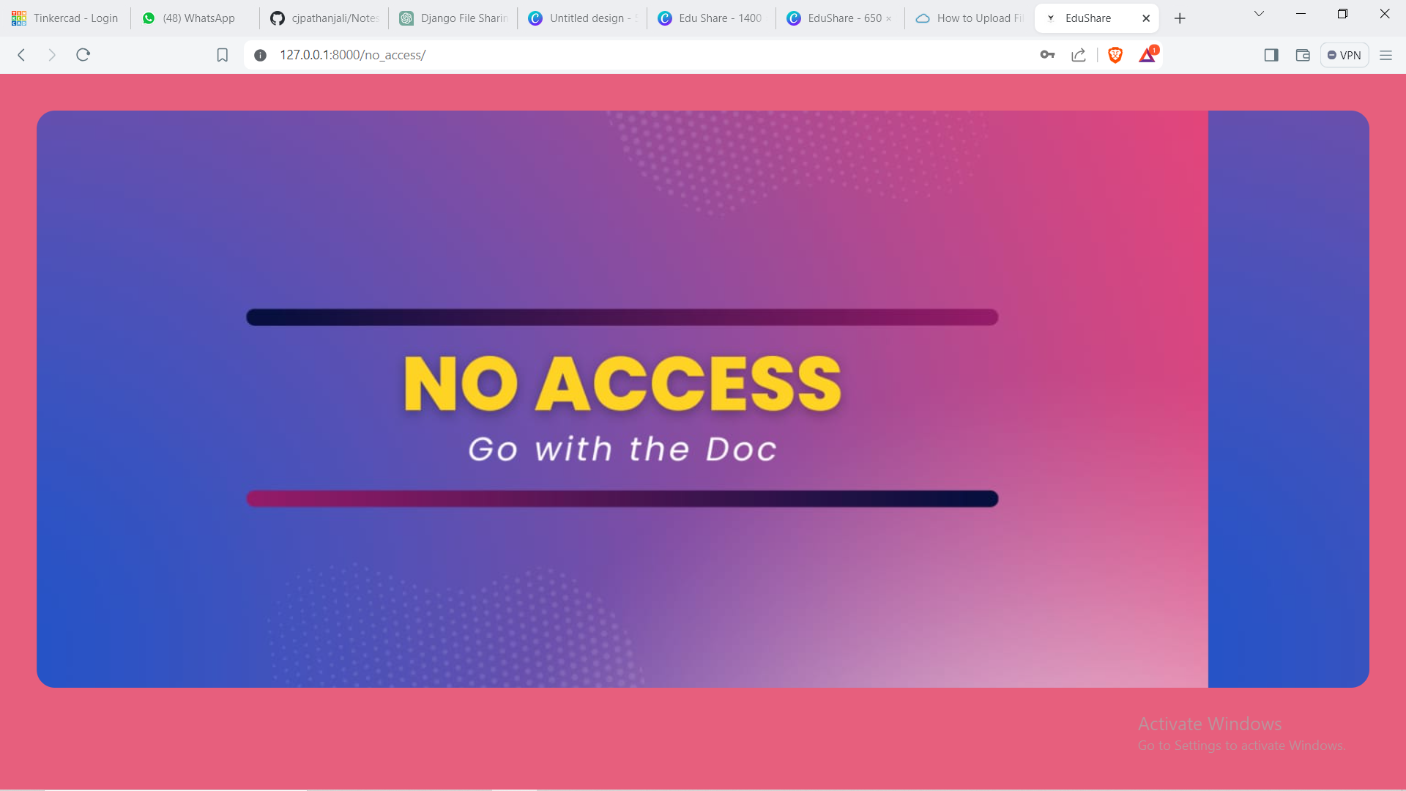
No access

Slide 14
Future Enhancements:
Future Enhancements:Real-time Collaboration: Implement features for real-time collaboration on documents, such as simultaneous editing and commenting.Advanced Search: Enhance the search functionality with filters, sorting options, and the ability to search within file contents.Integration with Learning Management Systems (LMS): Integrate the application with popular LMS platforms to streamline file sharing within existing educational workflows.File Versioning: Implement version control for files, allowing users to track changes and revert to previous versions if needed.Integration with Cloud Storage: Enable users to link their cloud storage accounts .

Slide 15
Conclusion
In conclusion, the development of a web application for file sharing between students and teachers using Django offers a valuable solution to enhance collaboration and efficiency in educational settings. By providing a centralized platform for uploading, downloading, and managing files, the application streamlines the file-sharing process and improves organization.Key features such as user authentication, group management, access control, notifications, and search functionality contribute to a user-friendly experience. Future enhancements like real-time collaboration, advanced search, and integration with learning management systems will further enhance the application's utility and user engagement.

Slide 16
Thank You!
Notes:
Thank You !!

